Slide 1
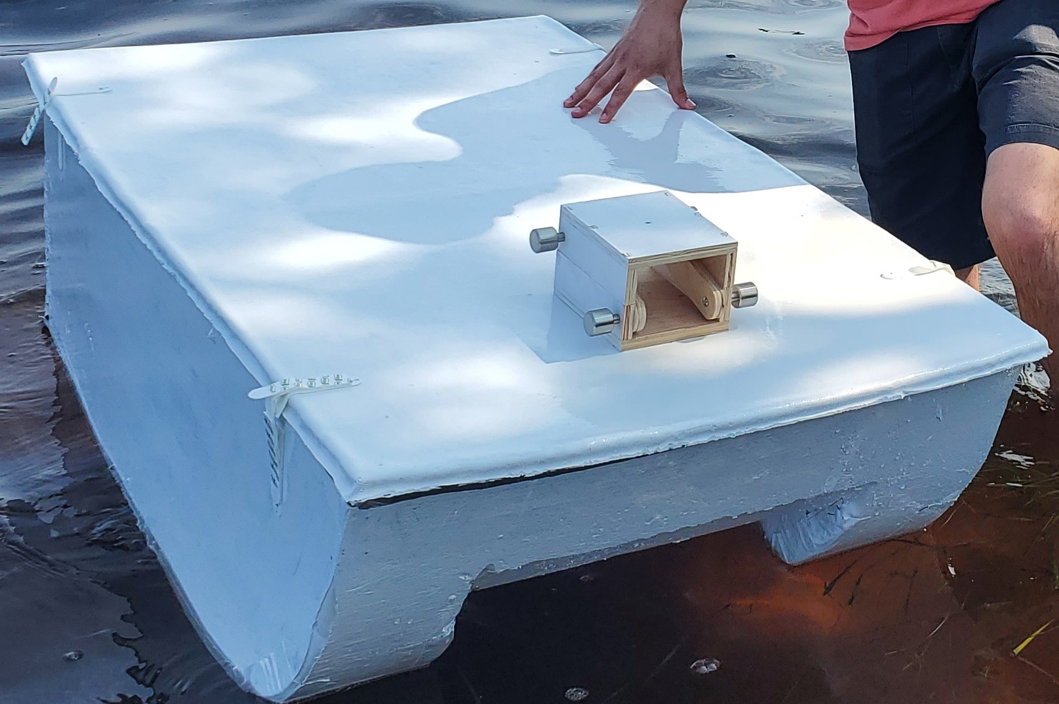



Final Presentation Team 524PC RoboBoat Pt. 2
By: Tamara McCaskill, Joseph Earnest, Manning Owens, Steven Harrington, Bryson Potts

Slide 2
Prototyping and Test Readiness
Prototypes
The Hull
The Lid
The Tilt Mechanism
Propulsor Hot-Swap
Test Readiness
The Assessment Plan
Description of Tests
Safety Plan
Bryson Potts 2

Slide 3
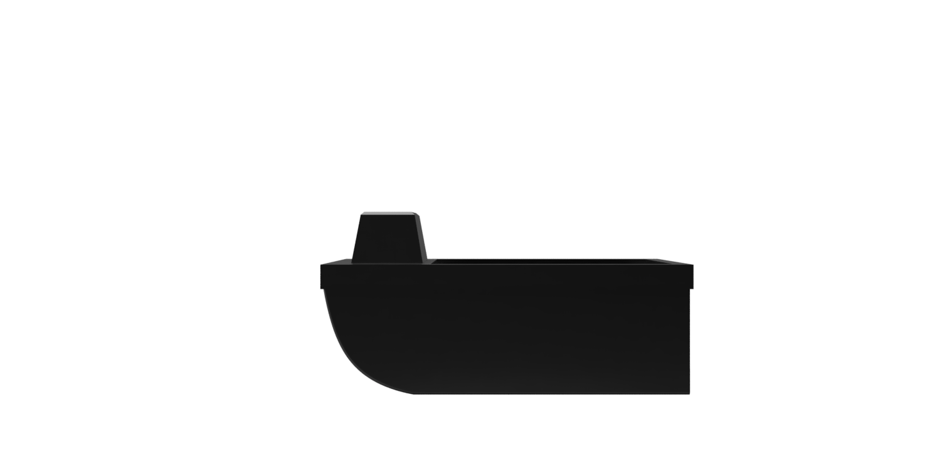
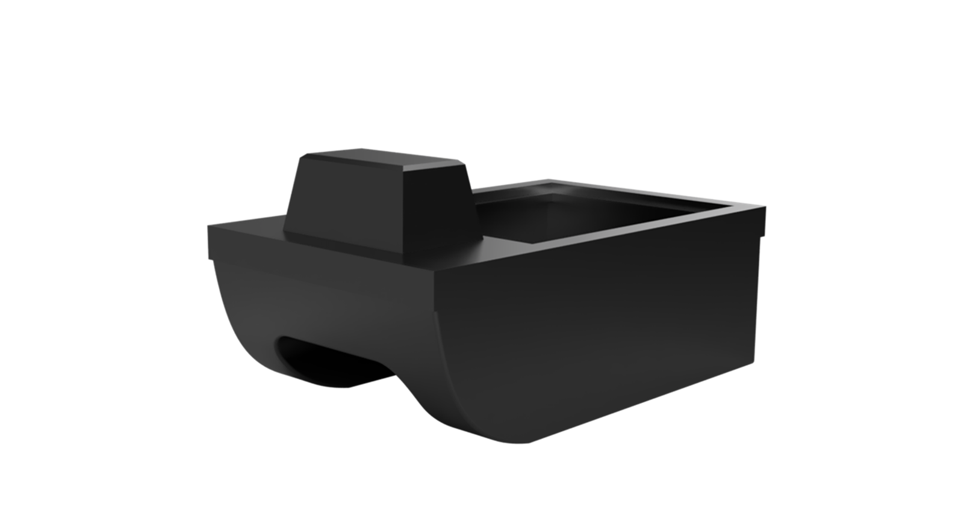
H
L
B.O.A.T
Length is 1.2 meters
Height is 0.7 meters
Material of construction is E6 Fiberglass
Weight estimate of Hull + Lid is 13.26 Kg or 29 lbs. (SolidWorks material estimate)
Bryson Potts 3

Slide 4
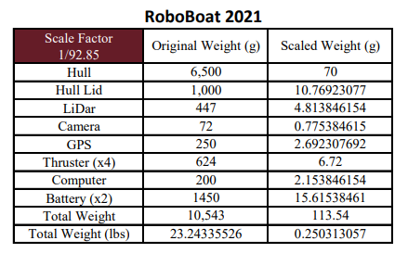
Prototypes
Hull
Finalize a model to construct
3D print said model
Observe how it sits in water
Lid
Determine LiDAR tower size
Finalize hatch size
LiDAR Tilt Mechanism
Create test mechanism
Propulsor Hot-Swap
Test making more propulsor hot-swaps
Bryson Potts 4

Slide 5
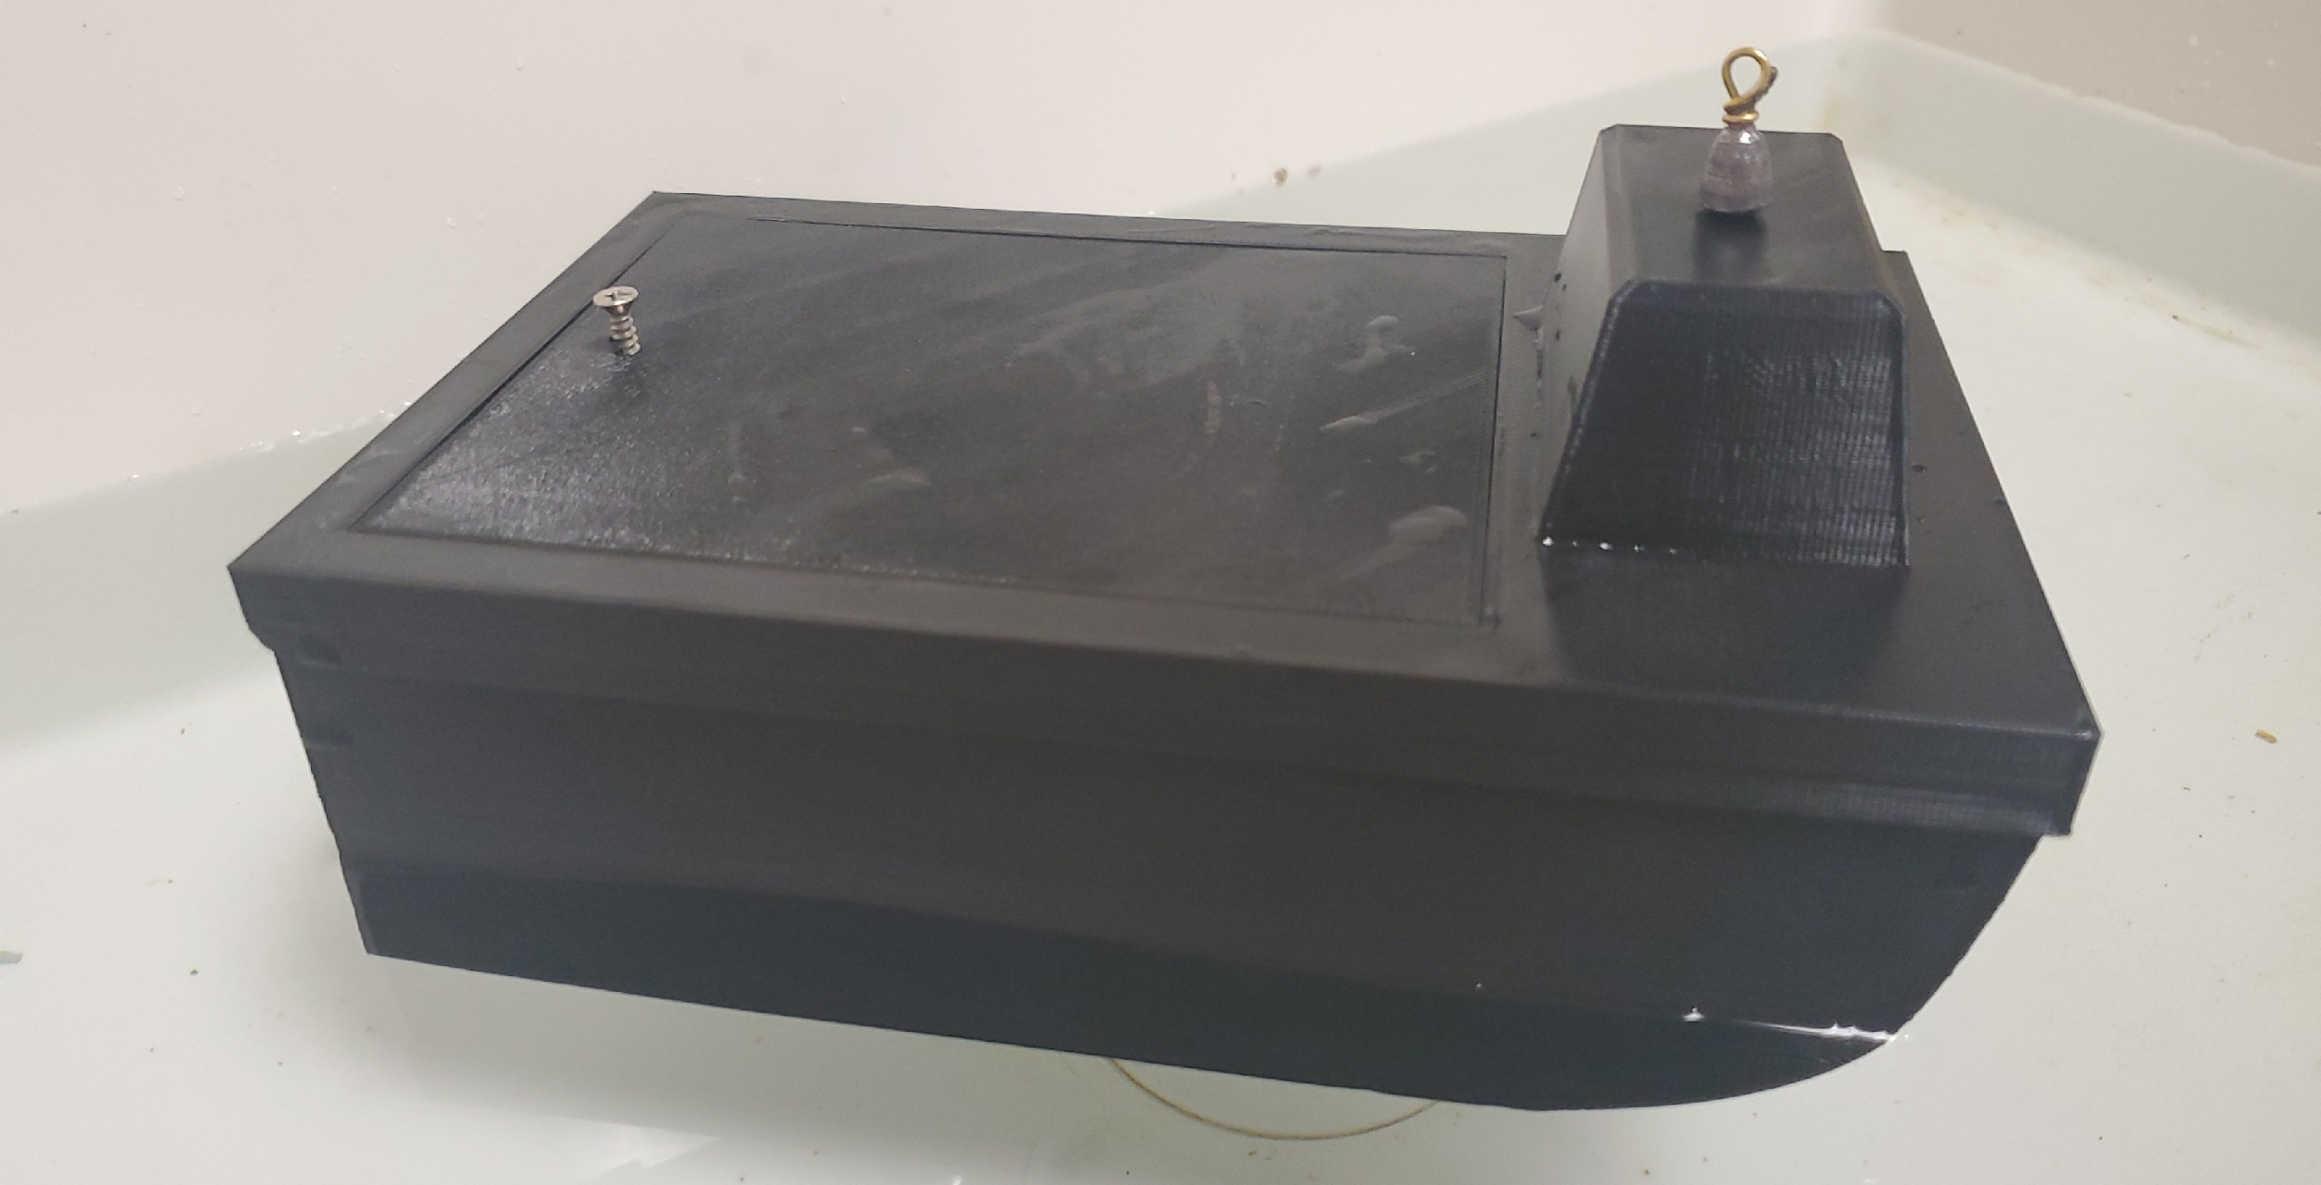
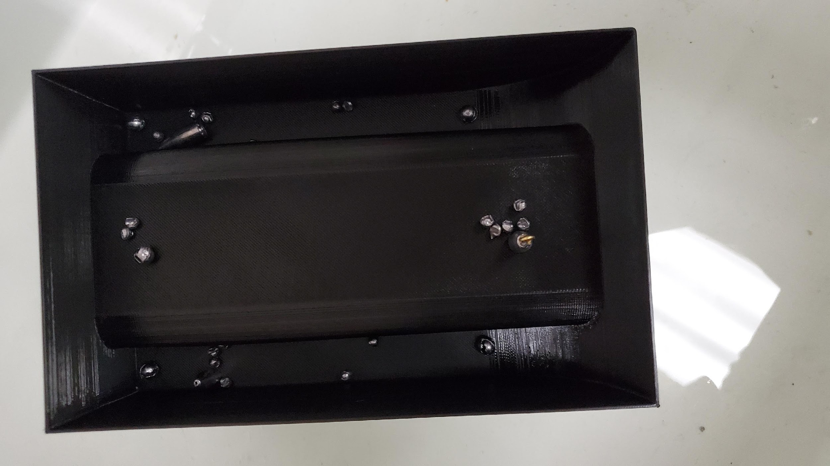
The Hull
3D modeled in Fusion 360 for FDM 3D printing (1/16 volume scale)
Printed in Hatchbox PLA filament
Lead fishing weights used as the scaled components
Bryson Potts 5

Slide 6
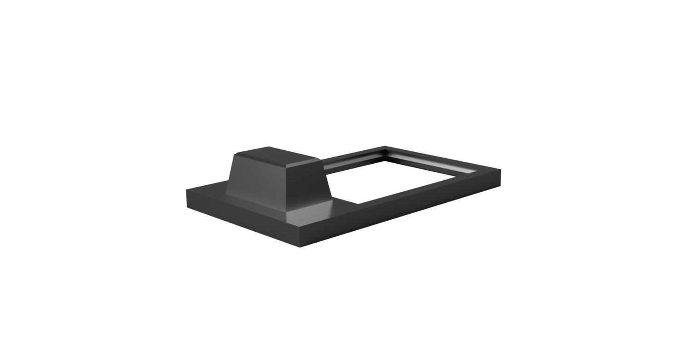
The Lid
3D modeled in Fusion 360 for FDM 3D printing (1/16 volume scale)
Printed in Hatchbox PLA filament
Spacious hatch for easy access to electrical components
Bryson Potts 6

Slide 7
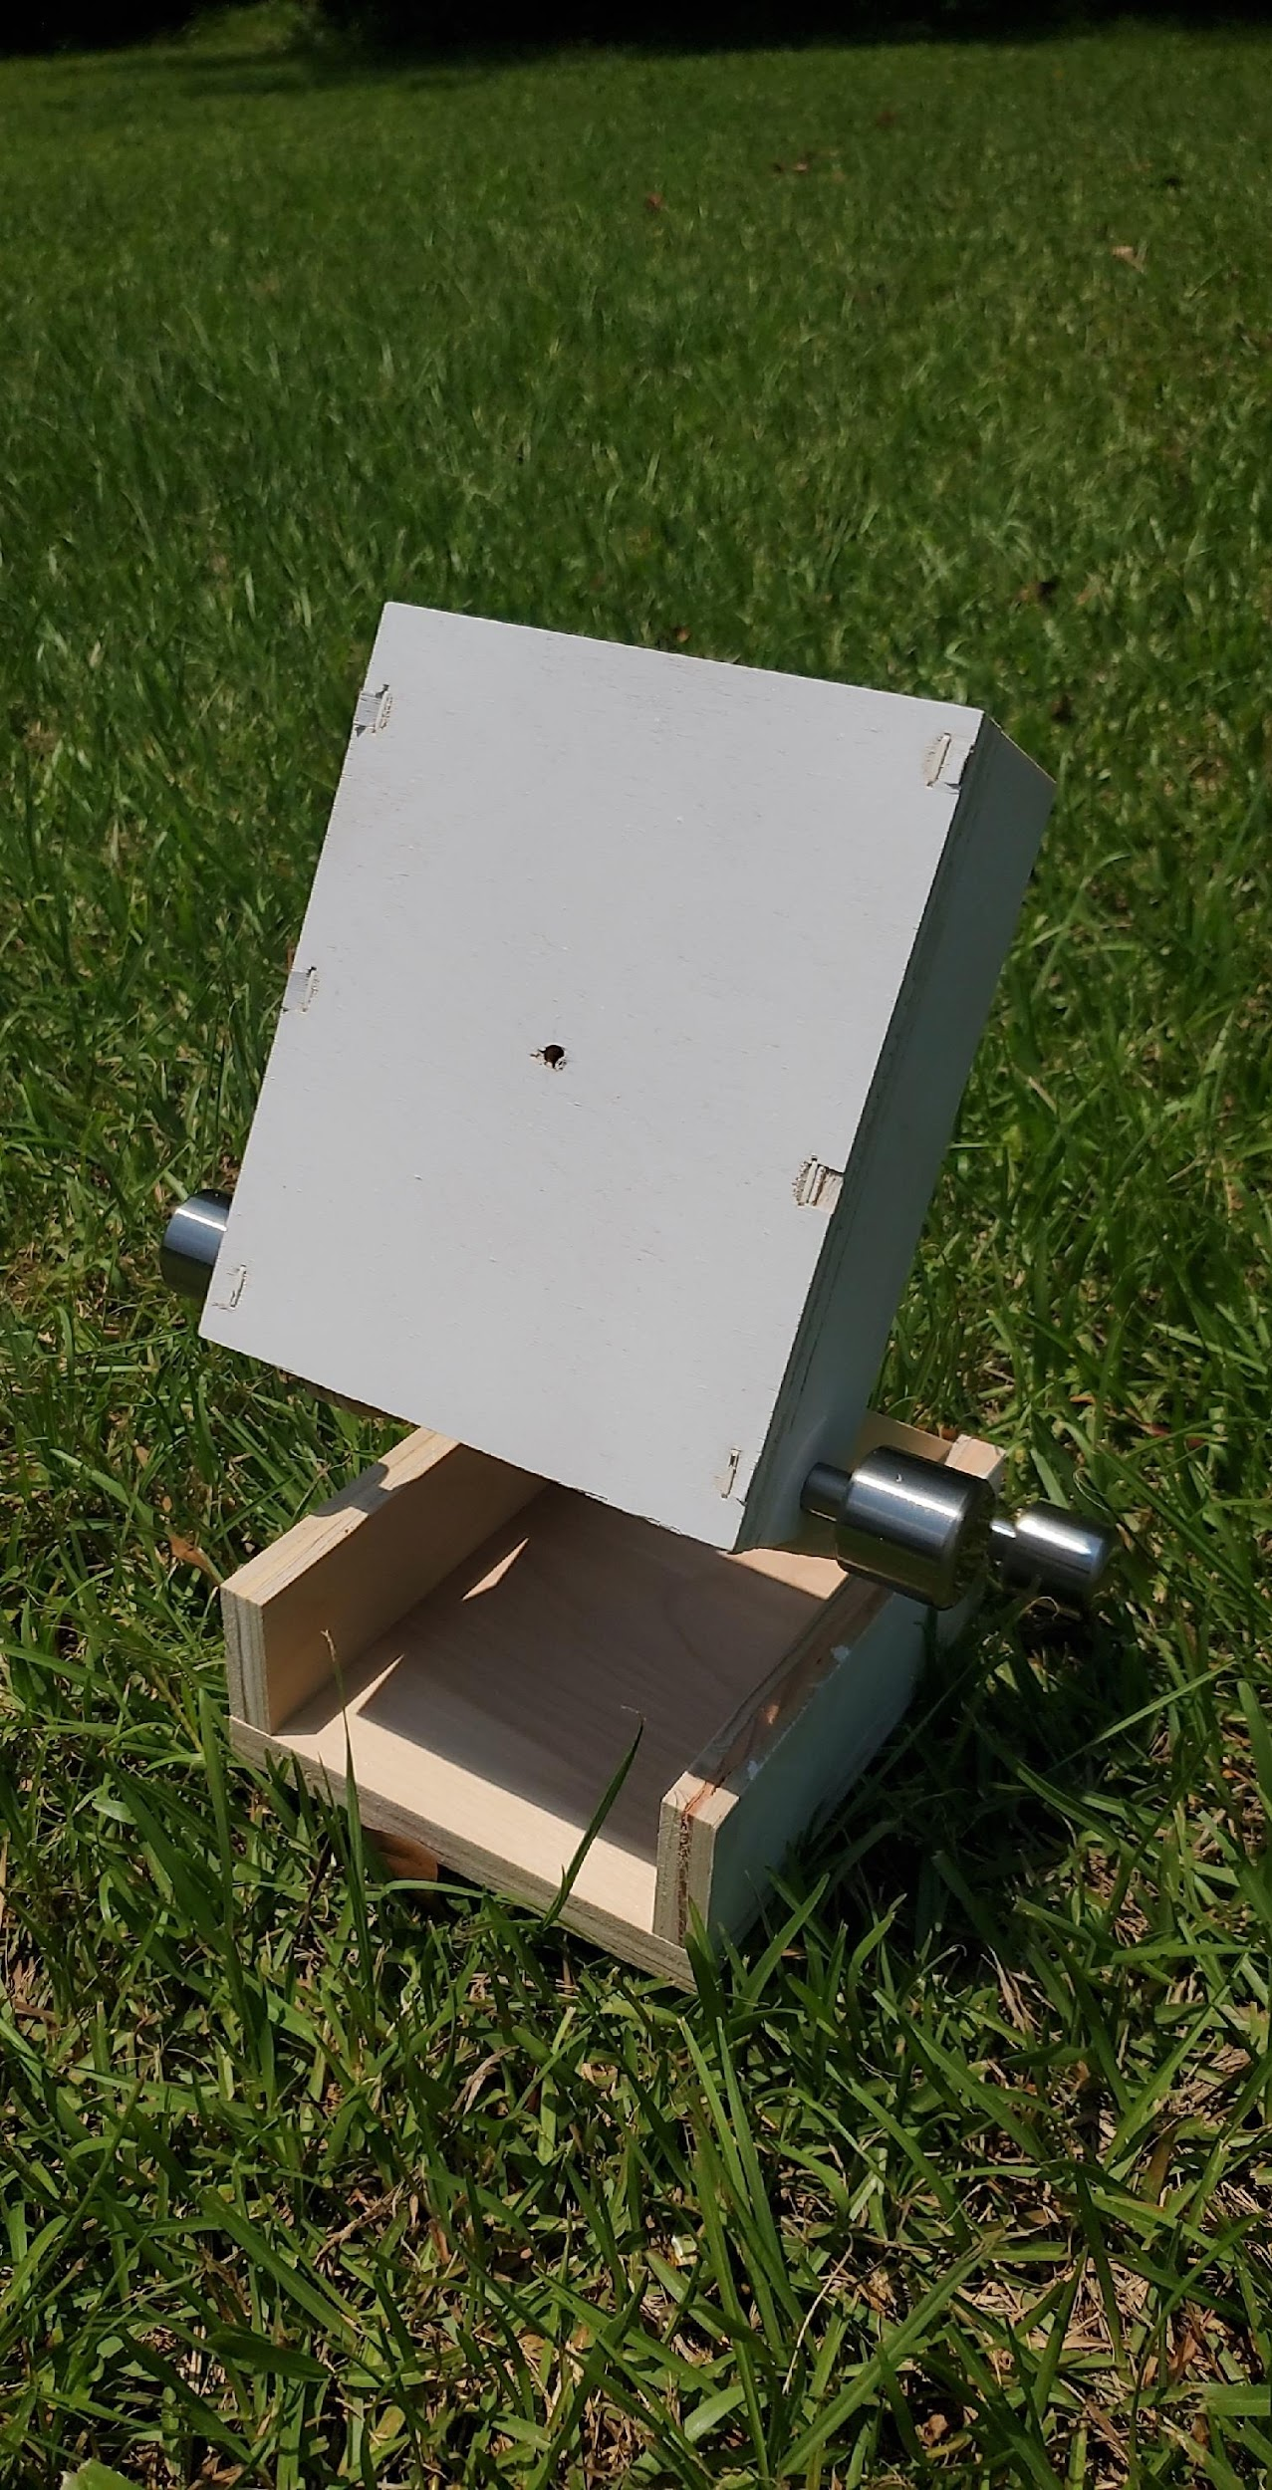
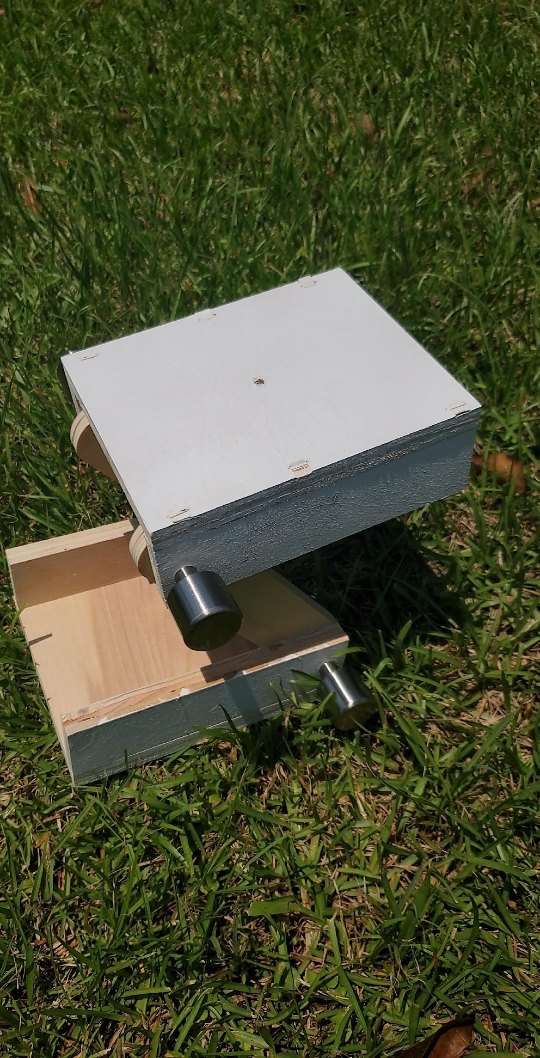
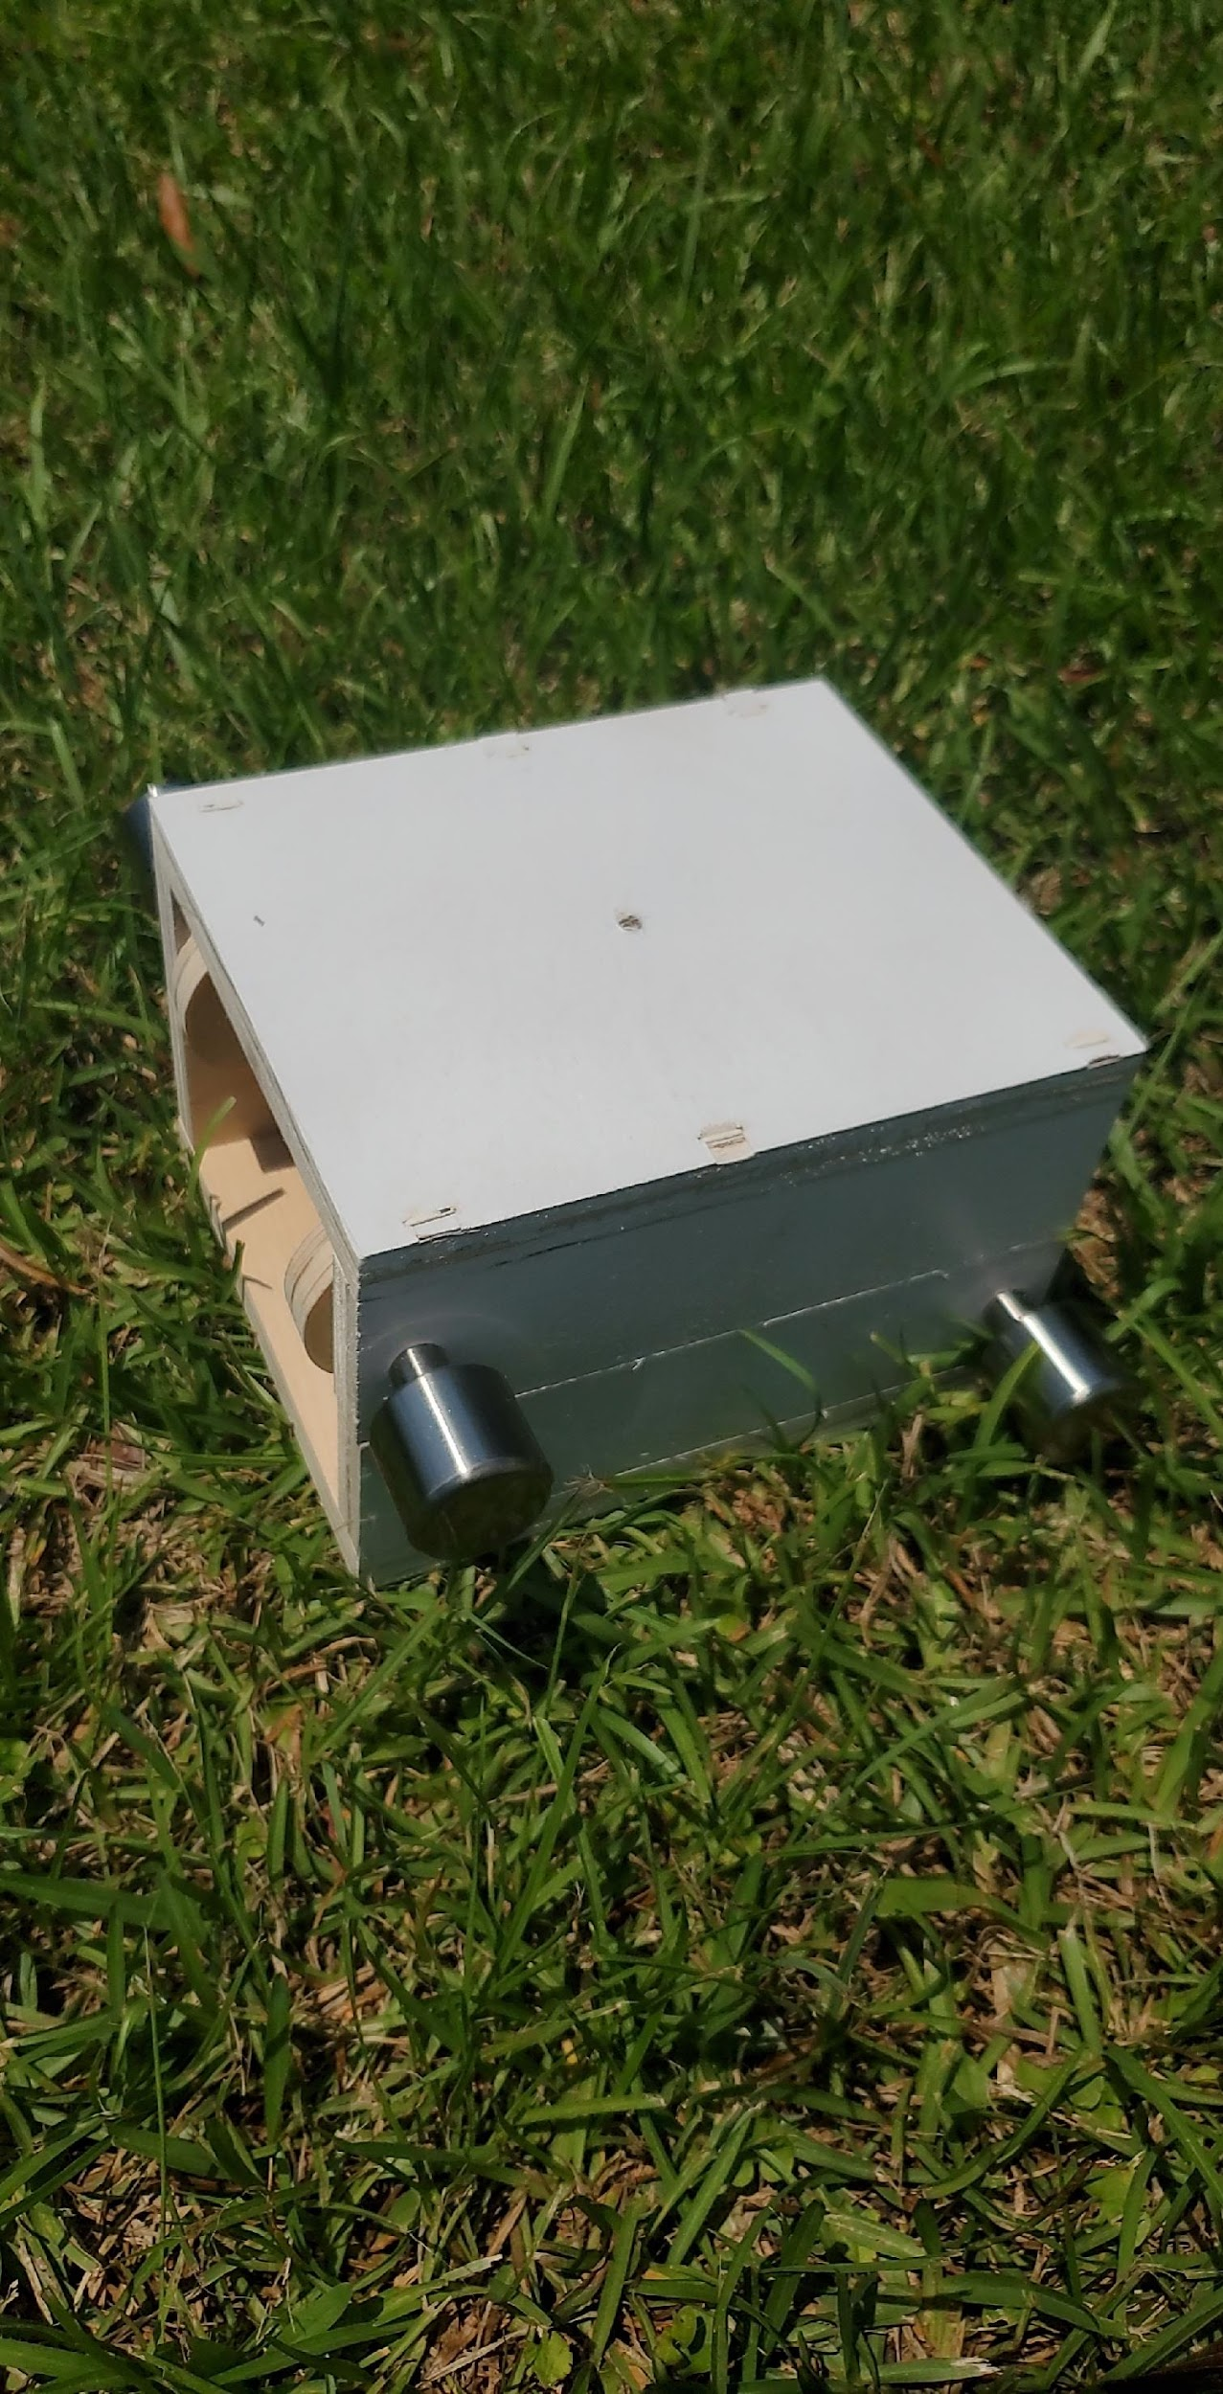
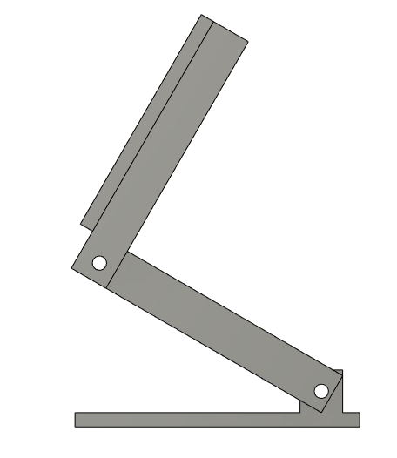
The Tilt Mechanism
Designed to adjust the angle at which the LiDAR will sit on the boat
Bryson Potts 7

Slide 8
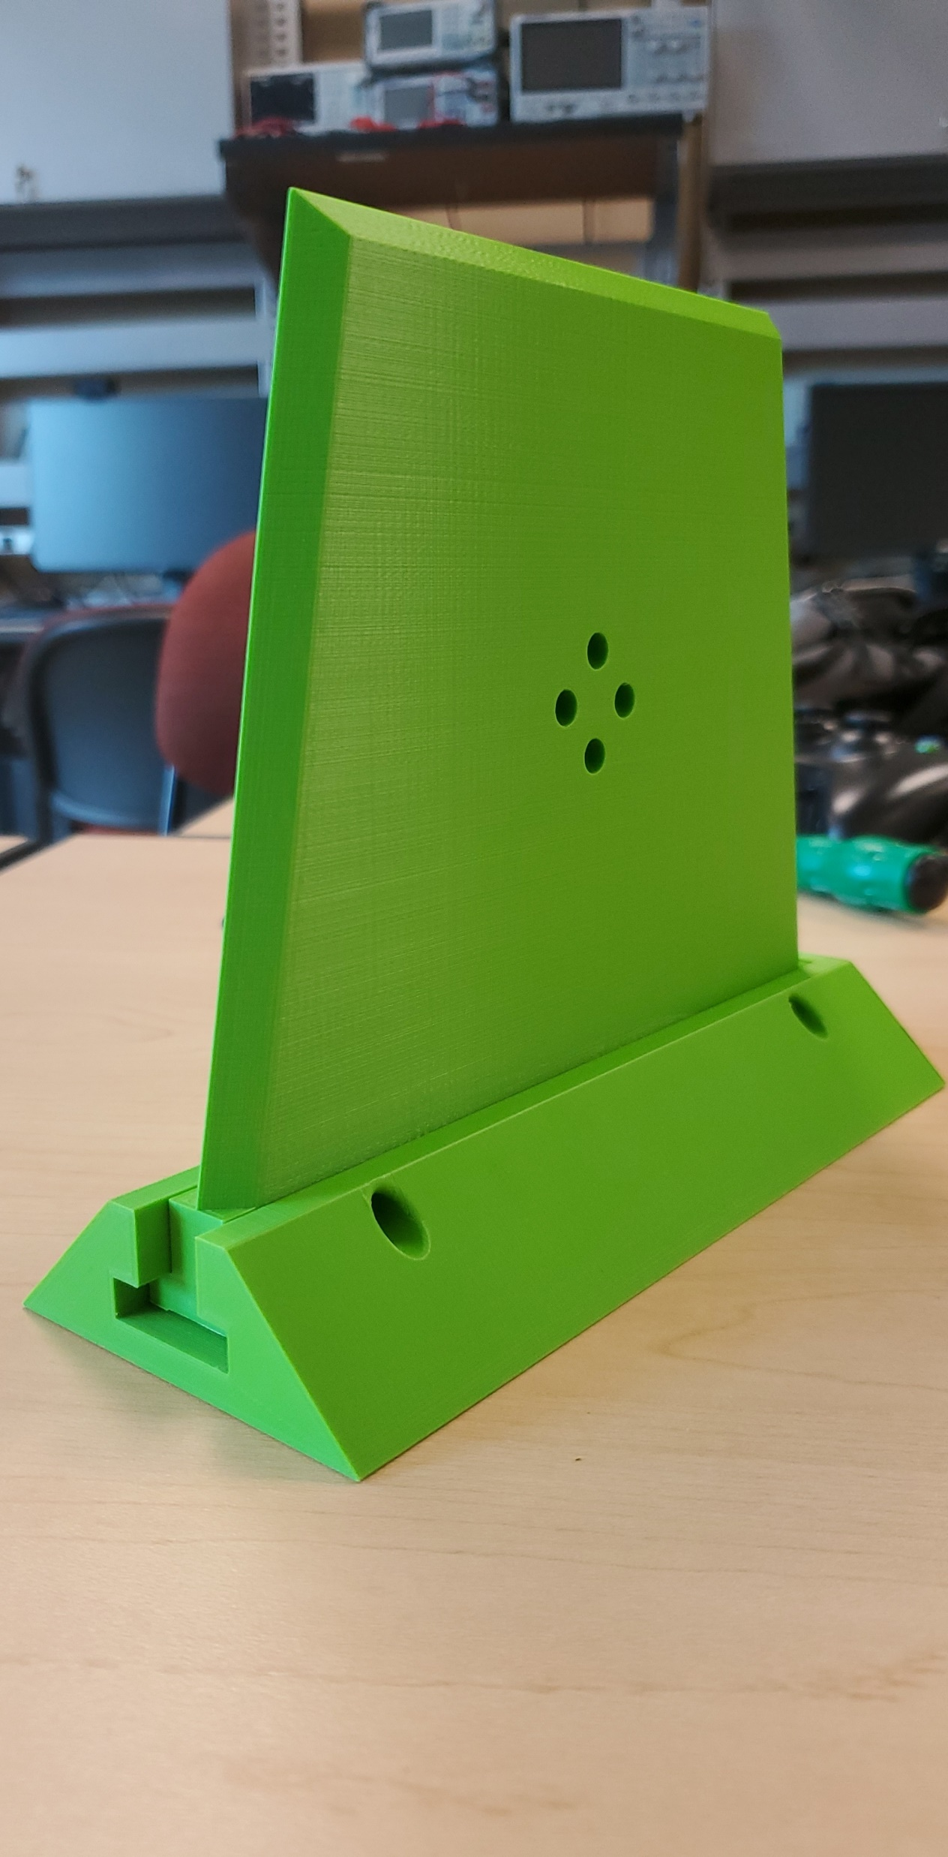
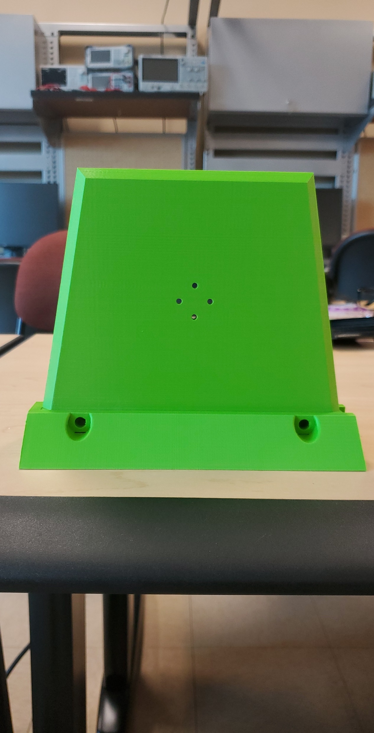
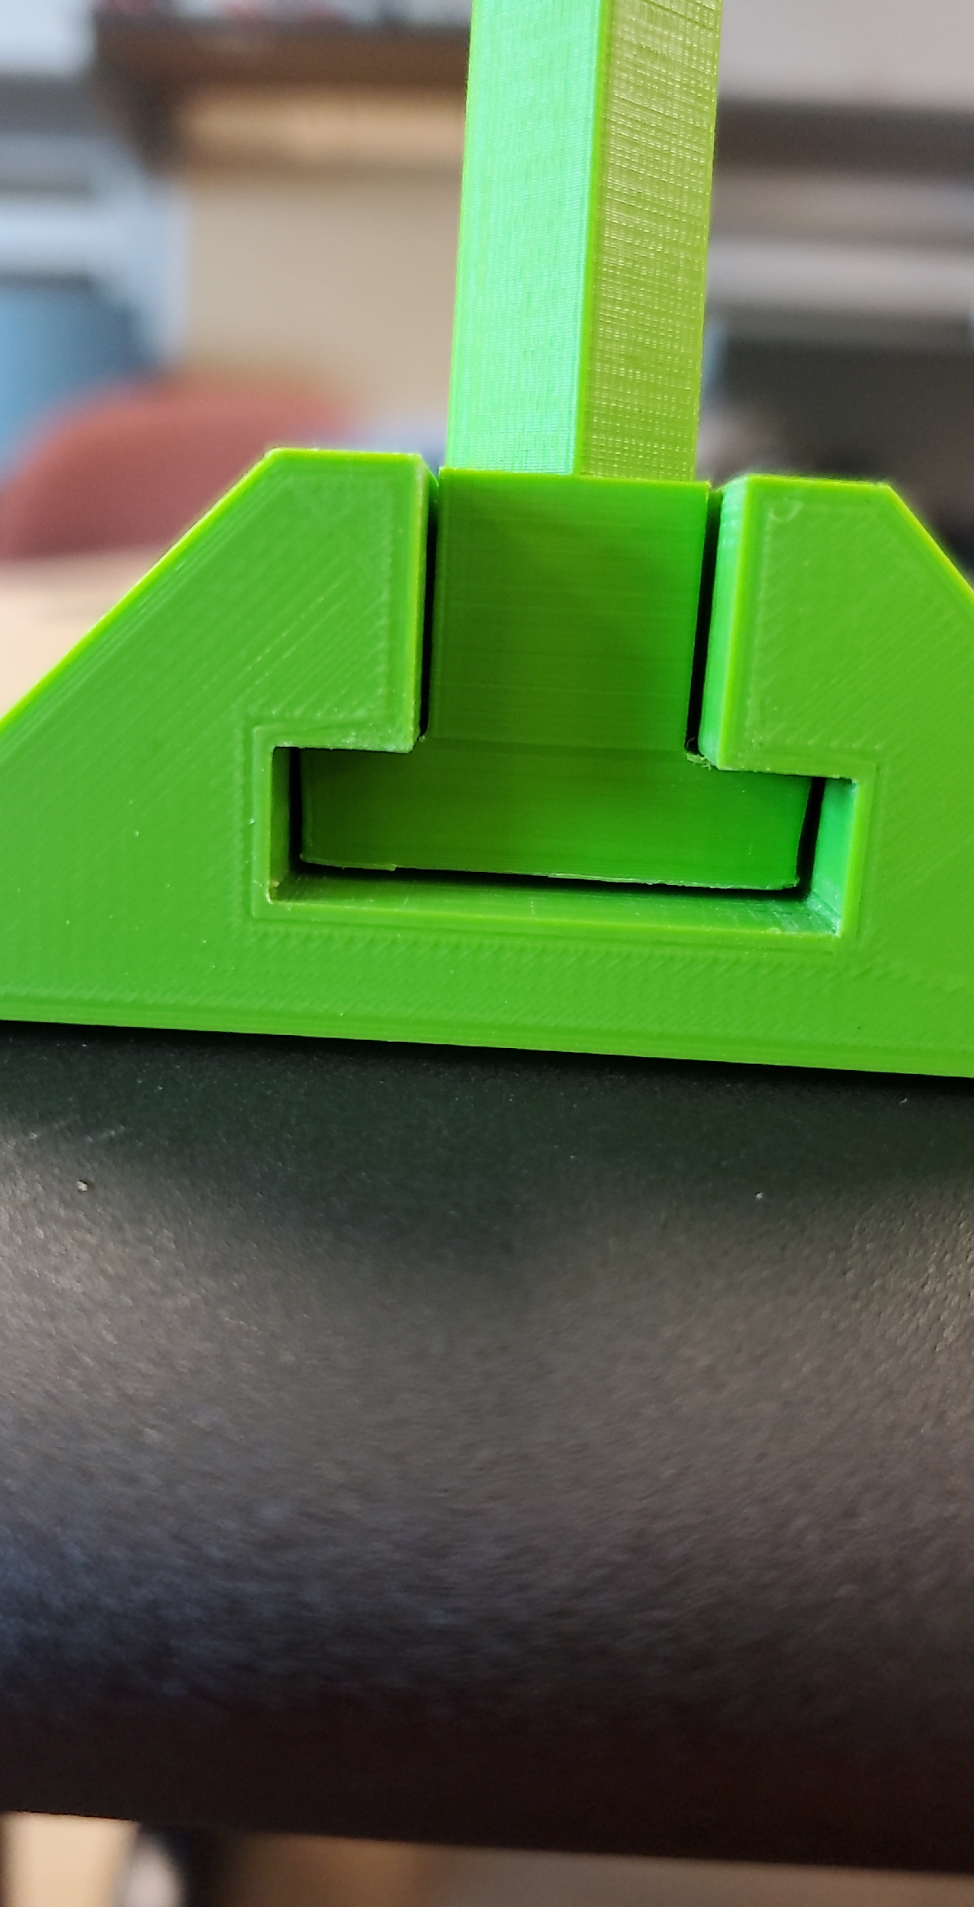
The Propulsion Hot Swap
Allows for quickly interchanging the propulsors
Also allows the boat to sit on the ground without being supported by the propulsors
Recreate the model on hand to be 3D printed
Bryson Potts 8

Slide 9
Fabrication Planning
Initially planned to have the hull and lid manufactured at the HPMI in Tallahassee.
Planned to have hull and lid manufactured at Gulf Coast State College.
Hand lay-up was done to manufacture the hull and lid by team members in thermal lab space.
Steven Harrington 9

Slide 10
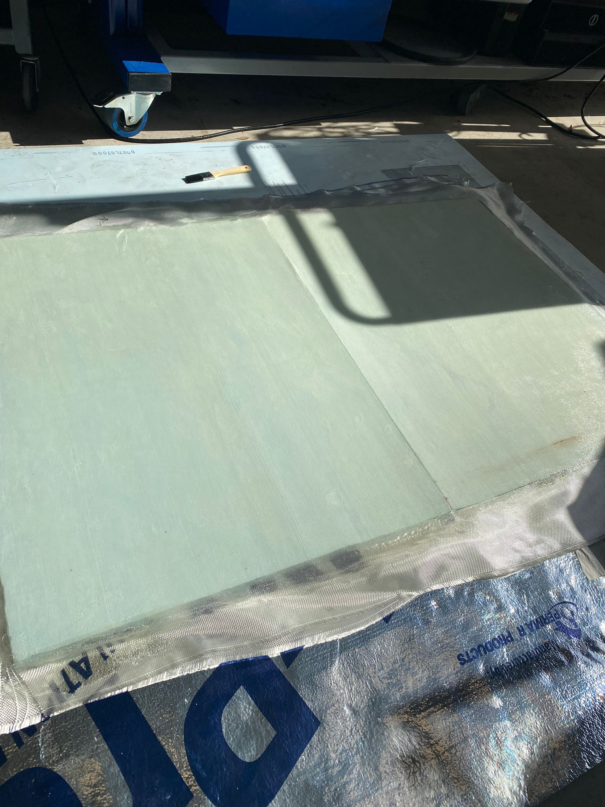
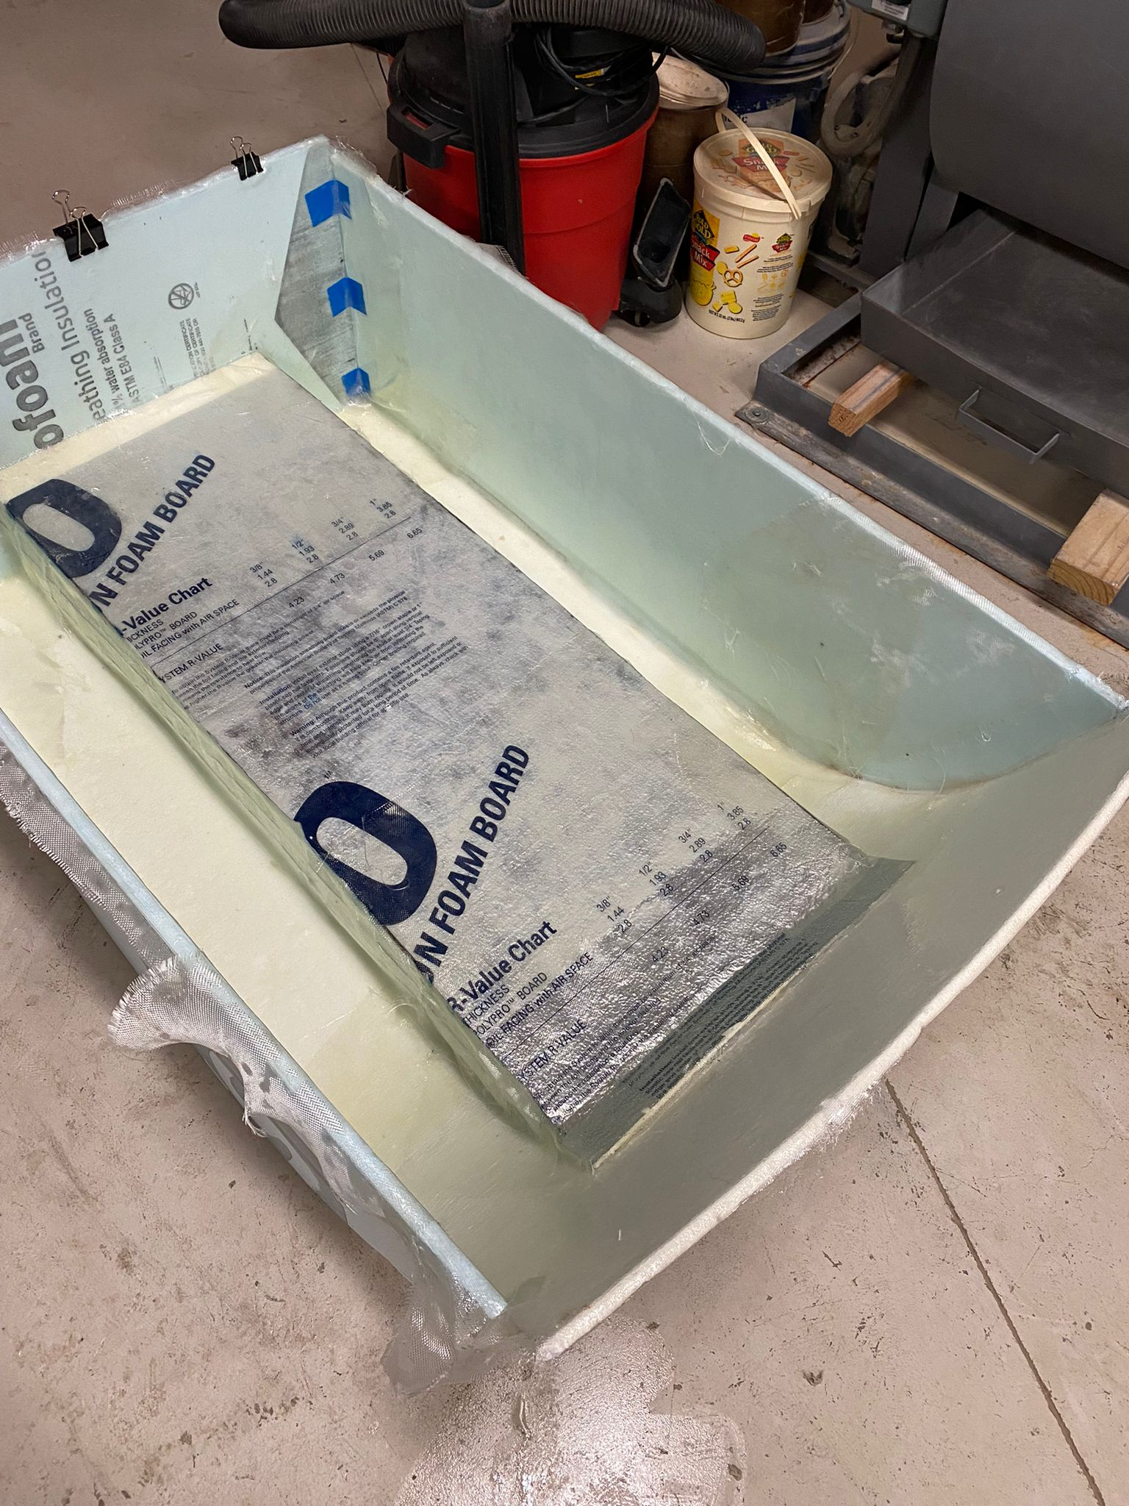
Manufacturing Process
The tower on the lid was removed after observing that the LiDAR tilt mechanism would facilitate the purpose of the tower.
A positive mold was made for lid fabrication. (Left)
A negative mold was made for hull fabrication. (Right)
Steven Harrington 10

Slide 11
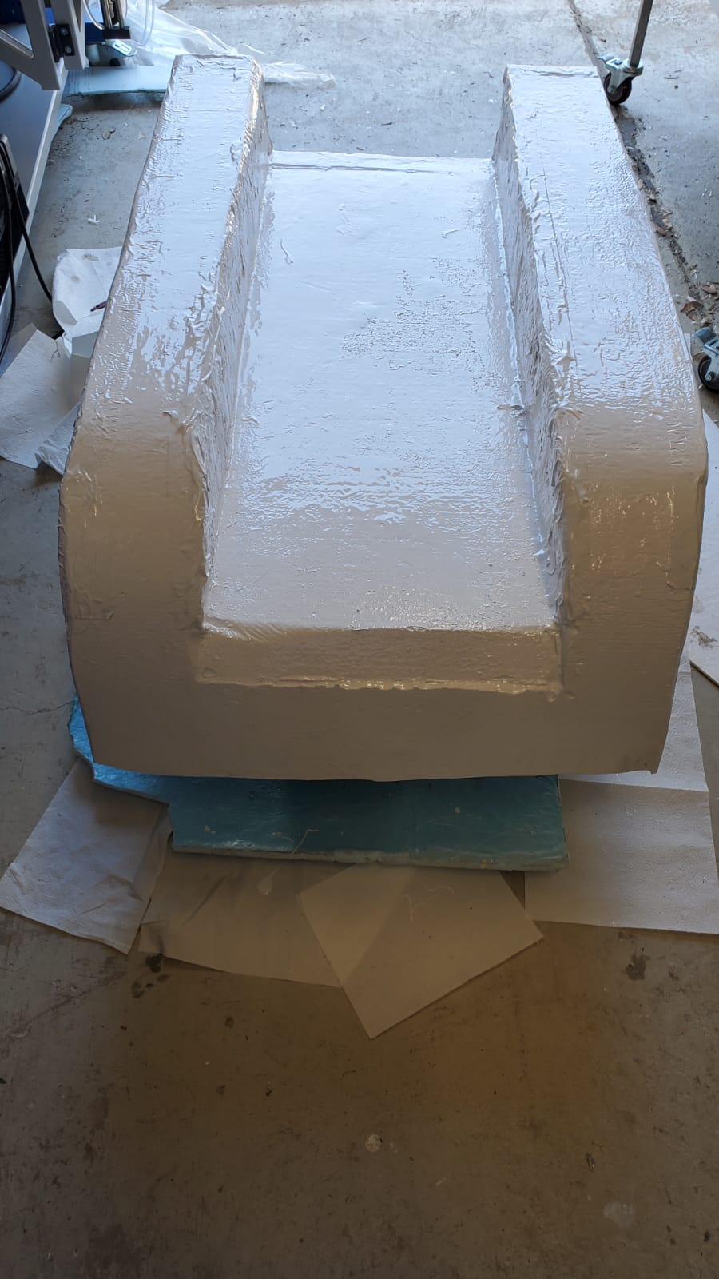
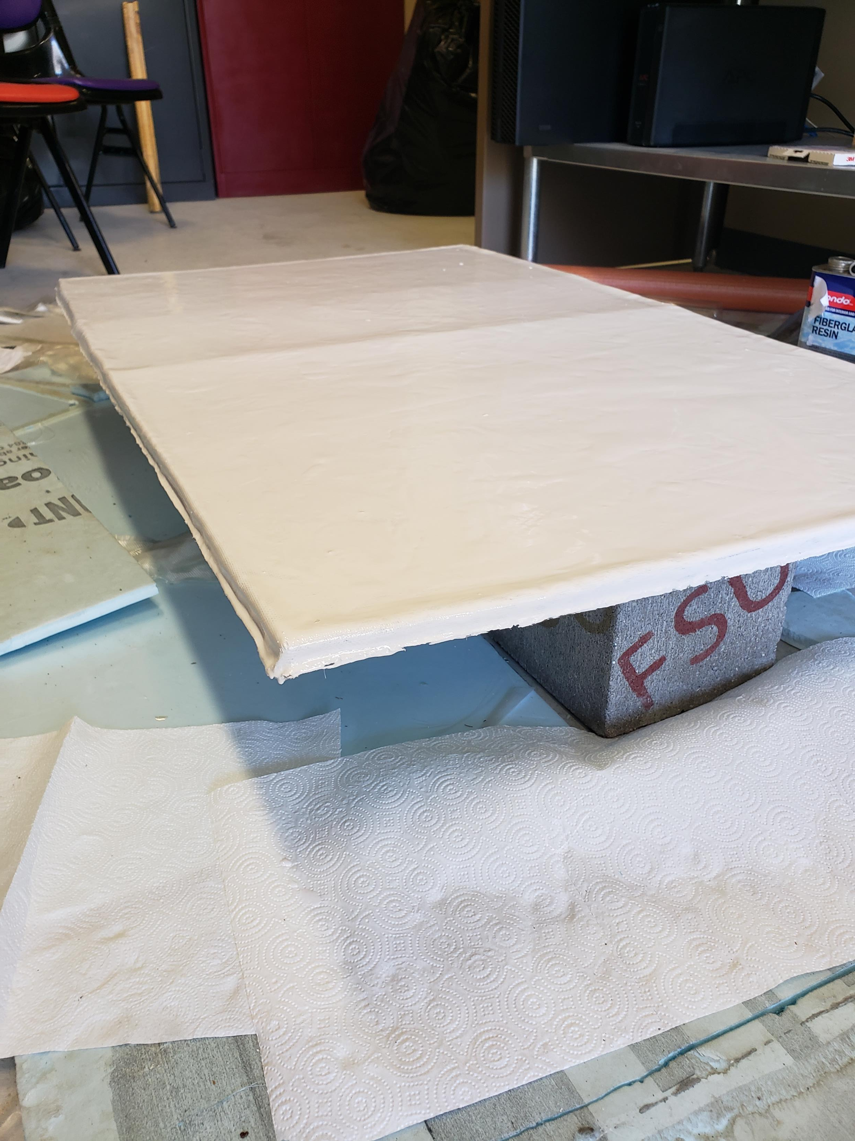
Manufacturing Process
After conducting a float test, any holes and leaks were patched.
Once cured the surface was sanded and painted.
Steven Harrington 11

Slide 12
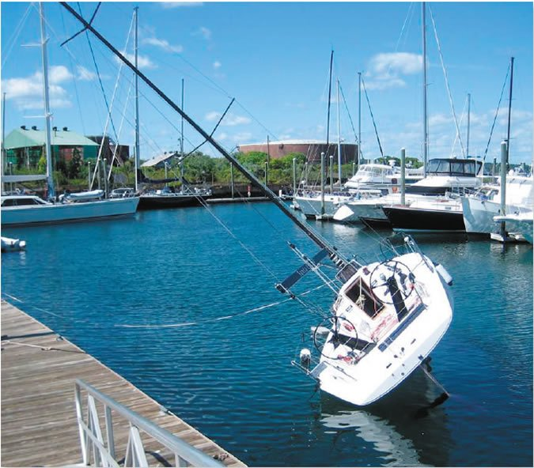
Assessment Plan
Floatation
Observe floatation capabilities
Floats for at least 30 mins
Floats at desirable stability
Stability
Does it sit level?
Does it flip when force is applied.
Sub-Systems
Test the LiDar tilt mechanism
Test the propulsor hot-swaps
Operation
Does the boat work after EE integration?
Bryson Potts 12

Slide 13
Test | Target | Metric
Floatation | Float for at least 30 minutes | Time floating without taking on water
Stability | Sit level in the water | Use level to see stability in water
Sub-Systems | LiDar tilt mechanism works Propulsor hot swap works | LiDar scan has good visibility Propulsors can be easily swapped
Operation | Boat has all electronics implemented and functions | A combination of all the above metrics.
Bryson Potts 13

Slide 14
Floatation and Stability
Possible locations to test the boat include:
Gulf Coast Pool
The Bay
Can test as early as the 19th of July depending on:
Boat being manufactured
Weather
Authorization
Bryson Potts 14

Slide 15
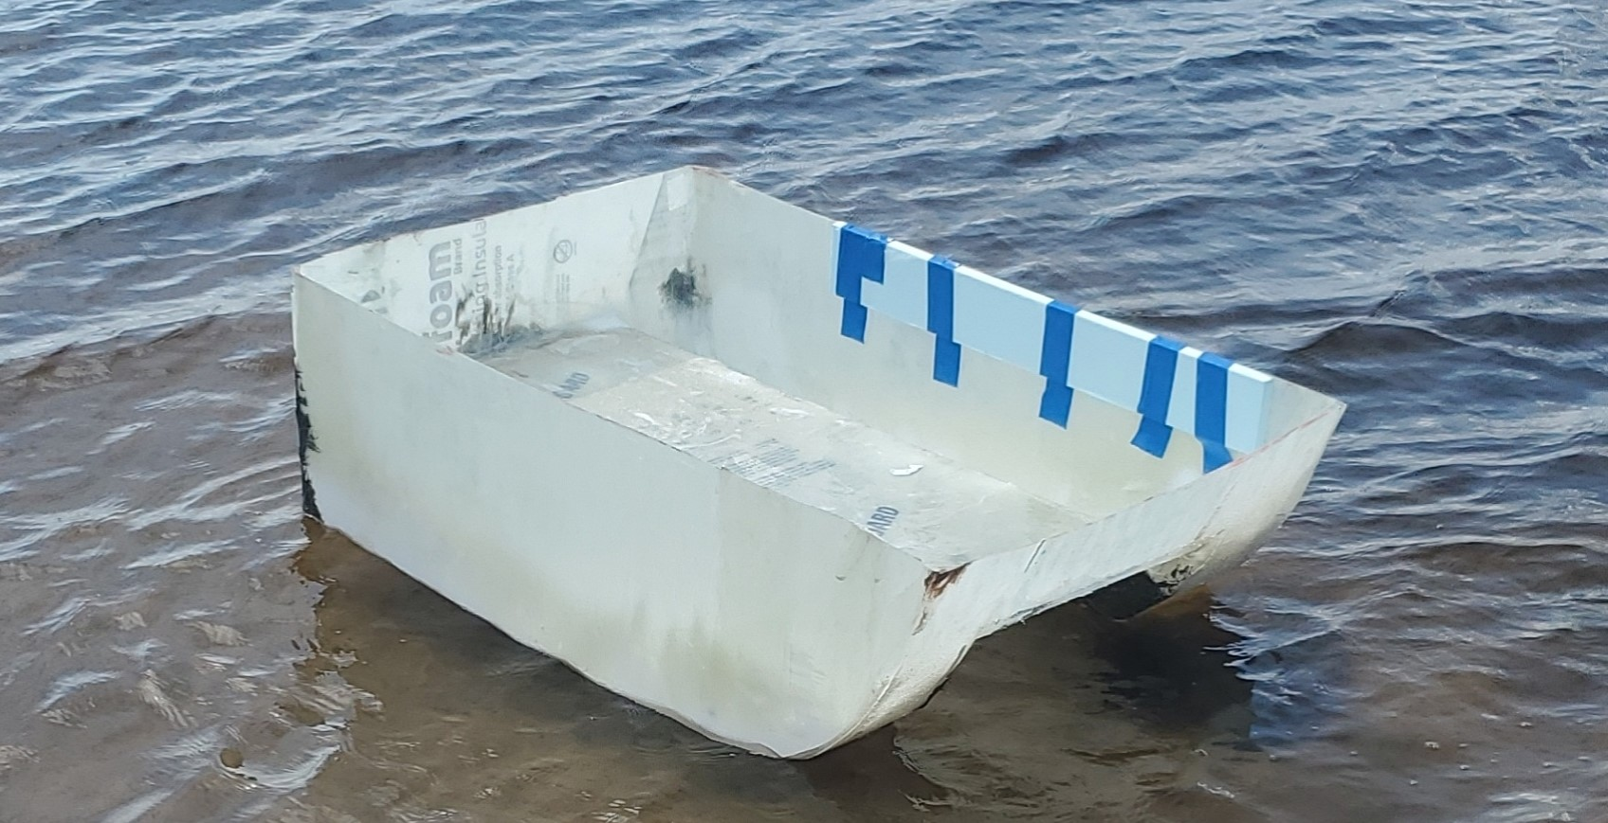
Floatation and Stability
Bryson Potts 15

Slide 16
Sub-Systems and Operation
Sub-Systems consists of:
The Propulsor Hot-Swaps
The LiDar tilt mechanism
This testing can begin…
EE has integrated their components
Bryson Potts 16

Slide 17
Safety Plan
Safety Concern | Safety Plan
Person falling in water | No running near water, also have floatation devices on hand
Boat flipping/sinking | Start at low power, move to high power.
Boat getting stranded in the middle of water | Ensure boat is fully charged, connections are secure.
Boat catching on fire | Have a fire extinguisher on hand
Collision between boat and obstacles | Clear unwanted obstacles from water
Bryson Potts 17

Slide 18
Roboboat Results
As a result of the competition going to online/more conceptual, we did not have a hull made until the latter part of the semester
With regards to the competition, we did not place or win any money
Manning Owens 18

Slide 19
EE Integration
The boat hull is finished
The Electrical Engineering group will be able to implement all the hardware to be able to control this boat with a remote
Our hull is strong and tough enough to be able to handle anything the EE’s put into it (within reason)
Manning Owens 19

Slide 20
Advice for the Upcoming Groups
Get it made professionally if possible
Do not wait until the last minute!!
Do a positive mold as opposed to a negative mold
Flat-bottomed design?
Budget willing, look into making the hull out of other materials
Manning Owens 20

Slide 21



Questions? B.O.A.T (Best of All Time)

